Slide 1

Resiliency And High Availability In Microservice Applications
Fixing Common Pitfalls
SoftUni Team
Technical Trainers
Software University
https://softuni.bg

Slide 2
Table of Contents
Partial Failures
Database Resiliency
HTTP Resiliency
Messages Resiliency
The Outbox Pattern
Health Monitoring
Versioning & Logging
Avoiding Disasters

Slide 3
Questions
sli.do #microservices

Slide 4

Partial Failures

Slide 5
Partial Failures
In distributes applications there is an ever-present risk of partial failure
Because of unavailability
Because of bad implementation
Because of too many requests

Slide 6
Partial Failures
If you do not design your application to tolerate faults, even small downtimes will be amplified
As an example, 50 dependencies each with 99.99% of availability would result in several hours of downtime each month because of this ripple effect
Our applications must be defended against it

Slide 7
Partial Failures
Common solutions:
Asynchronous communication
Retries with exponential back off
Network timeouts
Circuit Breaker pattern to skip further calls
Provide fallbacks for queries and return empty values
Limit the number of queued requests

Slide 8
Database Resiliency

Slide 9
Database Resiliency
Sometimes the database may not be available for a couple of seconds (if the cloud is moving it, for examples)
The “Retries with exponential back off” solution works great in this case
Entity Framework & SQL Server has built-in features to support connection retries

Slide 10
Database Resiliency
services.AddDbContext<CatalogContext>(options =>
{
options.UseSqlServer(Configuration["ConnectionString"],
sqlServerOptionsAction: sqlOptions =>
{
sqlOptions.EnableRetryOnFailure(
maxRetryCount: 10,
maxRetryDelay: TimeSpan.FromSeconds(30),
errorNumbersToAdd: null);
});
});

Slide 11
HTTP Resiliency

Slide 12
HTTP Resiliency
Install Microsoft.Extensions.Http.Polly:
.AddTransientHttpErrorPolicy(policy => policy
.OrResult(result => result.StatusCode == HttpStatusCode.NotFound)
.WaitAndRetryAsync(6, retry =>
TimeSpan.FromSeconds(Math.Pow(2, retry))))
.AddTransientHttpErrorPolicy(policy => policy
.CircuitBreakerAsync(5, TimeSpan.FromSeconds(30)));

Slide 13
Messages Resiliency

Slide 14
Messages Resiliency
MassTransit gives you easy options to configure:
consumers.ForEach(consumer => rmq
.ReceiveEndpoint(consumer.FullName, endpoint =>
{
endpoint.PrefetchCount = 12; // Number of CPUs is default
endpoint.UseMessageRetry(x => x.Interval(5, 100));
endpoint.ConfigureConsumer(bus, consumer);
}));

Slide 15
The Outbox Pattern

Slide 16
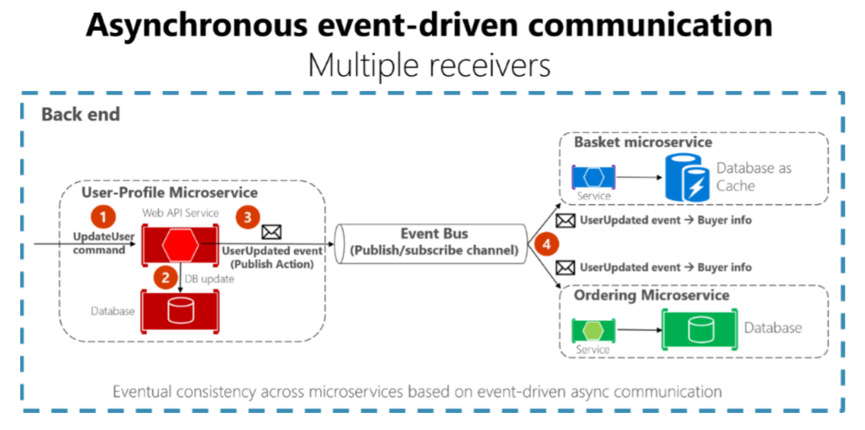
The Outbox Pattern

Slide 17
The Outbox Pattern
Create an additional table holding the integration events between microservices
Before publishing to the event bus – create a local database transaction
Updating the entity and saving the event as “pending”
Publish the event for the other microservices

Slide 18
The Outbox Pattern
If the publishing is successful – mark the event as “completed” with a new transaction
Have a background job to check periodically for failed “pending” events and publish them to the event bus
Guarantees you eventual consistency
Make sure you save yourself from database failures too!

Slide 19
The Outbox Pattern
The receiver microservice should do one of the following
Make sure the operations can be performed multiple times without affecting the result
Recognize duplicated messages and discard them

Slide 20
The Outbox Pattern
Idempotent messages:
Should be like “set the price to $40.00”
And not like “add $5.00 to the price”
Recognizing events can be done by adding a GUID to every event
Or use the infrastructure’s built-in features

Slide 21
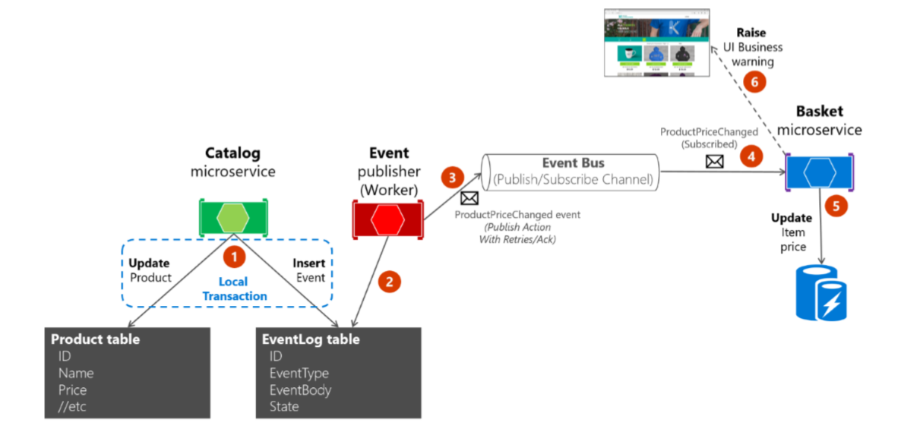
The Outbox Pattern

Slide 22
The Outbox Pattern
Add a global Message model:
private string serializedData; // Note: this is a field!
public int Id { get; set; }
public Type Type { get; set; }
public bool Published { get; set; }
[NotMapped]
public object Data
{ // Make sure you ignore null values!
get => JsonConvert.DeserializeObject(this.serializedData, this.Type);
set => this.serializedData = JsonConvert.SerializeObject(value);
}

Slide 23
The Outbox Pattern
Add entity configuration:
builder.HasKey(m => m.Id);
builder.Property<string>("serializedData")
.HasField("serializedData");
builder.Property(m => m.Type).IsRequired()
.HasConversion(
t => t.AssemblyQualifiedName,
t => Type.GetType(t));

Slide 24
The Outbox Pattern
Add base DbContext:
public DbSet<Message> Messages { get; set; }
public abstract Assembly ConfigurationsAssembly { get; }
protected override void OnModelCreating(ModelBuilder builder)
{
builder.ApplyConfiguration(new MessageConfiguration());
builder.ApplyConfigurationsFromAssembly(this.ConfigurationsAssembly);
base.OnModelCreating(builder);
}

Slide 25
The Outbox Pattern
Add services to save messages in the database:
Saving entities and messages should be in a transaction!
public interface IDataService<in TEntity>
where TEntity : class
{
Task MarkMessageAsPublished(int id);
Task Save(TEntity entity, params Message[] messages);
}

Slide 26
The Outbox Pattern
Install HangFire:
HangFire.Core
HangFire.SqlServer
Hangfire.AspNetCore
Register the dashboard (available at /hangfire)
if (app.ApplicationServices.GetService<MessagesHostedService>() != null)
{
app.UseHangfireDashboard();
}

Slide 27
The Outbox Pattern
Register HangFire:
services
.AddHangfire(config => config
.SetDataCompatibilityLevel(CompatibilityLevel.Version_170)
.UseSimpleAssemblyNameTypeSerializer()
.UseRecommendedSerializerSettings()
.UseSqlServerStorage("connectionString"));
services.AddHangfireServer();
services.AddHostedService<MessagesHostedService>();

Slide 28
The Outbox Pattern
Register HangFire:
services
.AddHangfire(config => config
.SetDataCompatibilityLevel(CompatibilityLevel.Version_170)
.UseSimpleAssemblyNameTypeSerializer()
.UseRecommendedSerializerSettings()
.UseSqlServerStorage("connectionString"));
services.AddHangfireServer();
services.AddHostedService<MessagesHostedService>();

Slide 29
The Outbox Pattern
Create a HostedService using IRecurringJobManager:
public Task StartAsync(CancellationToken cancellationToken)
{
this.jobManager.AddOrUpdate(
nameof(MessagesHostedService),
() => this.ProcessMessages(),
"*/5 * * * * *");
return Task.CompletedTask;
}

Slide 30
The Outbox Pattern
Create a HostedService using IRecurringJobManager:
public void ProcessMessages()
{
var messages = this.data.Set<Message>()
.Where(m => !m.Published).ToList();
foreach (var message in messages)
{
this.publisher.Publish(message.Data, message.Type);
message.Published = true;
this.data.SaveChanges();
}
}

Slide 31
Health Monitoring

Slide 32
Health Monitoring
Health monitoring allow near-real-time information about the state of your containers and microservices
You need the following packages in your servers:
AspNetCore.HealthChecks.UI.Client
AspNetCore.HealthChecks.SqlServer
AspNetCore.HealthChecks.Rabbitmq
You may need additional ones depending on your infrastructure

Slide 33
Health Monitoring
Setup the health services:
Implement IHealthCheck for customizations
public static IServiceCollection AddHealth(
this IServiceCollection services,
IConfiguration configuration)
{
var healthChecks = services.AddHealthChecks();
healthChecks.AddSqlServer("connectionString");
healthChecks.AddRabbitMQ("connectionString“);
return services;
}

Slide 34
Health Monitoring
Setup the middleware:
MassTransit also need a health check configuration!
app.UseEndpoints(endpoints =>
{
endpoints.MapHealthChecks("/health", new HealthCheckOptions
{
ResponseWriter = UIResponseWriter.WriteHealthCheckUIResponse
});
endpoints.MapControllers();
});

Slide 35
Health Monitoring
Create a new project for the Watchdog:
Use the AspNetCore.HealthChecks.UI package
Add to the application configuration:
"HealthChecks-UI": {
"HealthChecks": [
{
"Name": "MyApp",
"Uri": "http://localhost:5001/health"
},
]},

Slide 36
Health Monitoring
Setup the Startup class
public void ConfigureServices(IServiceCollection services)
{ // You may use another storage
services.AddHealthChecksUI().AddInMemoryStorage();
}
public void Configure(IApplicationBuilder app)
{ // The default path is /healthchecks-ui
app.UseRouting()
.UseEndpoints(endpoints => endpoints.MapHealthChecksUI());
}

Slide 37
Versioning And Logging

Slide 38
Versioning
Typically microservices are deployed independently
Which mean that an API can break client applications
You will need to implement versioning
By URI, QueryString, or Headers
Your old and new API should be live at the same time to make sure the clients work correctly
HATEOAS is a more advanced approach
[Route("api/v1/[controller]")]

Slide 39
Logging
In a microservices application logging should be more central-oriented
Each separate application should write its own log stream (files)
These streams should be collected and aggregates by the infrastructure
Azure Diagnostics or Splunk, for example
Microsoft.Diagnostic.EventFlow

Slide 40
Avoiding Disasters

Slide 41
Avoiding Disasters
Don’t go polyglot
Using multiple technology stacks makes you reinvent the wheel multiple times
Don’t share databases or table ownerships
Imagine schema migrations and their consequences
Be careful with event logic code
Don’t copy paste code, extract to common classes

Slide 42
Avoiding Disasters
But be careful with common classed and logic
Microservices may depend on your changes
Don’t handcraft, use CI/CD
In a such complex solution, many things may go wrong
Don’t assume the network is reliable and fast
Make sure you have error handling and asynchronous communication
Write tests
For real, write tests – unit, integration, you name it…

Slide 43
Avoiding Disasters
Don’t create a SPA monolith
Separate the UI layer to API Gateway microservices
Involve the business in your overall architecture
The domain contexts should be well-defined in the organization
More information in this lecture (you will laugh hard):
https://www.youtube.com/watch?v=X0tjziAQfNQ

Slide 44

Summary
Partial Failures
Database Resiliency
HTTP Resiliency
Messages Resiliency
The Outbox Pattern
Health Monitoring
Versioning & Logging
Avoiding Disasters
…
…
…

Slide 45
Questions?
Notes:
45

Slide 46

License
This course (slides, examples, demos, exercises, homework, documents, videos and other assets) is copyrighted content
Unauthorized copy, reproduction or use is illegal
© SoftUni - https://about.softuni.bg/
© Software University - https://softuni.bg
Notes:
46

Slide 47
Trainings @ Software University (SoftUni)
Software University - High-Quality Education, Profession and Job for Software Developers
softuni.bg, about.softuni.bg
Software University Foundation
softuni.foundation
Software University @ Facebook
facebook.com/SoftwareUniversity
Software University Forums
forum.softuni.bg
Notes:
47

